Slide 1



CACHE BANK BUSINESS
Tech-Savvy Banking for Innovators
26-07-2024 | MORENA DLAMINI

Slide 2

CACHE BANK BUSINESS
Topics to be covered
Tech Stack overview
Repository Structure
Responsive Navigation
Hero & Endorsements
Features
Stats and Getting Started Section
Contact and Footer
Conclusion

Slide 3




Tech Stack Overview
The Cache Bank project utilizes a modern tech stack to ensure efficiency and scalability
HTML 5: Utilized for the structure and semantic markup of our bank web page.
CSS3 with Tailwind CSS: Utility-first styling for fast UI development.
Javascript: Utilized for dynamic behavior and interactivity in our application.

Slide 4
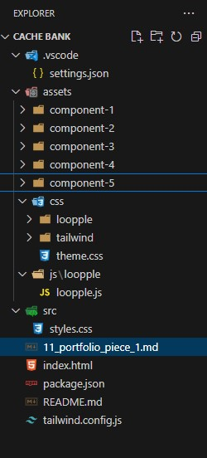
Repository Structure
Project Setup
Benefits of this organization
Clear Separation: Each component and asset type is stored in dedicated directories, enhancing maintainability.
Consistent Environment: VSCode settings file ensures a consistent development setup across the team.
Modular Structure: Component-specific directories facilitate easy updates and feature additions.
Centralized Styling: Organized CSS and JS directories help maintain a coherent styling and scripting approach.
Ease of Onboarding: README.md and structured directories make it easy for new developers to understand and contribute to the project.
Efficient Dependency Management: package.json file helps in managing project dependencies and scripts efficiently.

Slide 5
Component 1: Responsive Navigation
CSS Media Queries for Responsive Navigation
Tailwind CSS is used for styling, which includes built-in responsive design utilities. Media queries are used in the Tailwind CSS classes to create a responsive navigation bar.
Default Mobile Styles
The default styles are applied for mobile devices on this project. An example the navigation bar is initially hidden and toggled using JavaScript for mobile devices.
<nav class="hidden md:flex items-center gap-12 text-black">
Code Explanation
The hidden class ensures that the navigation links are hidden on mobile by default, and the md:flex class makes them visible on medium and larger screens.
Media Queries for Larger Screens:
Tailwind CSS uses md, lg, xl, etc., to apply styles for larger screens.
Example, md:flex ensures the navigation bar is displayed as a flex container starting from the medium screen size.
<div class="hidden md:flex items-center gap-3">
Code Explanation
The hidden class hides elements on smaller screens, and md:hidden can be used to hide elements starting from medium screens.
Navigation Bar Implementation
The navigation bar is implemented using JavaScript and Tailwind CSS for dynamic resizing and toggling.
Hamburger Menu for Mobile:
The hamburger button is used to toggle the mobile menu. This button is only visible on mobile devices (md:hidden).
JavaScript for Toggling Menú:
JavaScript is used to add interactivity for toggling the mobile menu.
Responsive Menú for Mobile:
The mobile menu is initially hidden (hidden class) and displayed when the hamburger button is clicked.
Header:
The <header> element is used to contain introductory content or navigational links.
Nav:
The <nav> element is used for the main navigation links.
Links and Buttons:
Using <a> for links and <button> for actions like "Log In" and "Sign Up“ for the landing page.

Slide 6
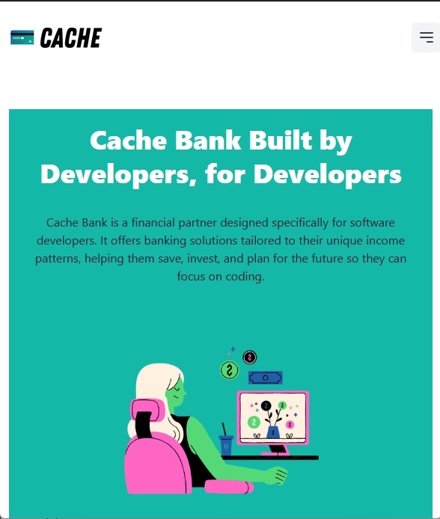
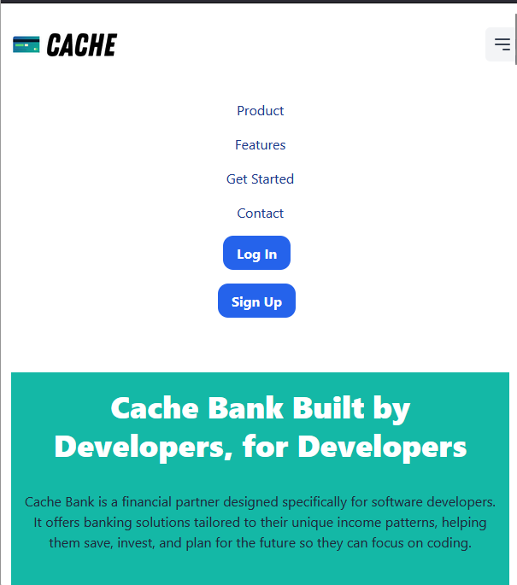
Component 1: Responsive Navigation
Hamburger Icon for mobile
Hamburger menu for mobile

Slide 7
Component 2: Hero & Endorsements
Incorporation of Endorsements from Credible Sources to Build Trust
These endorsements are strategically placed in a dedicated section on the homepage to immediately establish credibility and reassure visitors of the service's reliability and reputation.
Call to Action in the Hero Section
The hero section includes prominent call-to-action buttons that guide users to either "Get Started with Us" or "Find Out More.“
Creation of the Hero Section Using Tailwind CSS for Styling and Grid Layout for Alignment
The hero section is crafted using Tailwind CSS, leveraging its utility classes for styling and responsive design.
Grid Layout for Alignment:
The hero section uses a grid layout (md:grid md:grid-cols-2) to align the content into two columns, ensuring a balanced and organized presentation on medium and larger screens. For smaller screens, it falls back to a single-column layout for better readability.
Text Styling:
The text elements, including the main heading and paragraph, are styled with Tailwind CSS classes such as text-4xl, lg:text-6xl, font-extrabold, and text-white to ensure they are prominent and visually appealing.
Button Styling:
The call-to-action buttons are styled with different classes to make the attractive and interactive.
Image Styling:
The accompanying image is styled with classes such as w-3/6 and rounded-md to ensure it scales well and maintains a polished look.

Slide 8
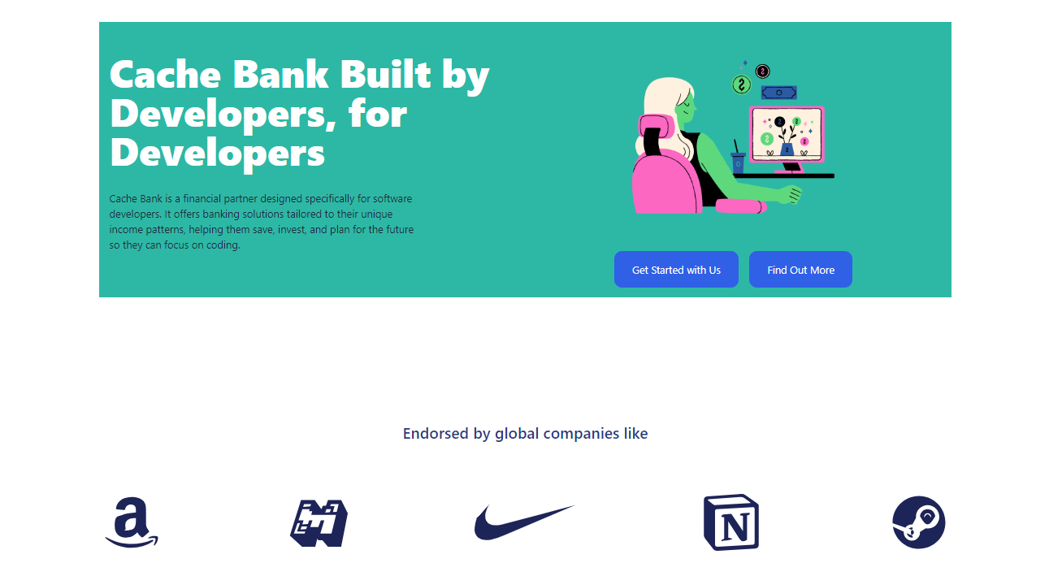
Component 2: Hero & Endorsements

Slide 9
Component 3: Features
CSS Flexbox and Grid for a Responsive Features Section
Flexbox:
Flexbox is used to center and align items, making it easier to create a responsive layout that adapts to different screen sizes.
Grid:
The Grid layout is used to organize the feature cards. This approach makes it easier to manage the layout for various screen sizes.
ARIA Roles for Accessibility
ARIA (Accessible Rich Internet Applications) roles are crucial for enhancing the accessibility of web applications. They help assistive technologies understand the structure and function of web elements.
1. Role region: Use this role to define the "Features" section as a significant region of the page.
2. Role list and listitem: Apply these roles to the feature cards to define them as a list for screen readers.
Notes:
Endorsements: Credible sources build trust, displayed prominently.
Call to Action: Encourages users to engage ("Get Started" or "Find Out More").
Tailwind CSS: Used for styling and responsive grid layout.

Slide 10
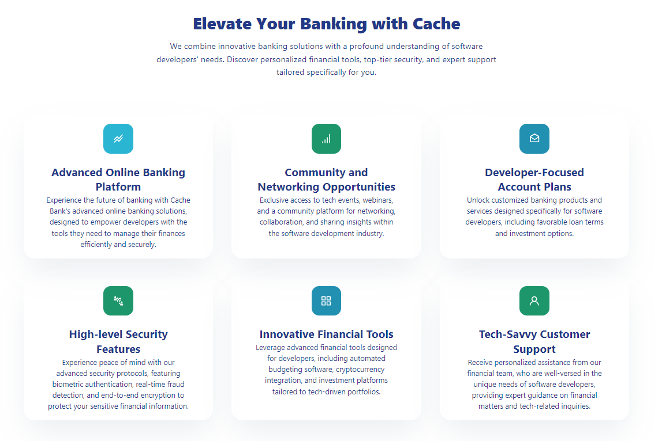
Component 3: Features

Slide 11
Component 4: Stats and Getting Started Section
Getting Started Section Design for Cache Bank
Flexbox and Grid Combination:
The 'Getting Started' section uses a combination of CSS Grid and Flexbox to ensure a responsive and visually appealing layout.
Consistent Spacing and Padding:
The use of margin ensures that there is consistent spacing around the section, making it visually distinct and appealing.
Gap utilities ae used to manage space between grid items and text elements respectively.
Typography and Color:
The use of different font sizes and weights helps in creating a visual hierarchy, making the content easy to read and engaging.
Colors are strategically used to differentiate headings.
Statistics Section
Grid Layout:
The statistics section is designed using a grid layout to ensure that statistics are displayed in a structured manner across different screen sizes.
Text Styling:
Large bold text is used for the numerical values to grab attention, while descriptions are kept smaller (text-base, font-medium) for a clear and balanced look.
JavaScript for Animating Statistics Counters:
The statistics counters are animated using JavaScript to create an engaging user experience. The counters increment their values dynamically when scrolled into view, drawing attention to key metrics.

Slide 12
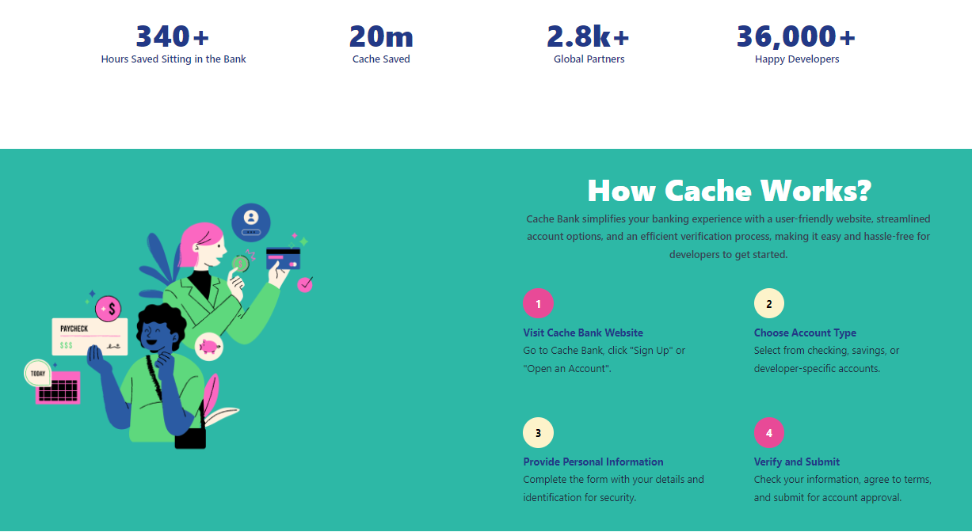
Component 4: Stats and Getting Started Section

Slide 13
Component 5 - Contact and Footer
Enhancing Footer Accessibility and Design
Accessible Footer Design:
- Clear, contrasting colors for readability.
- Logical order of links for screen readers.
- ARIA roles for improved accessibility.
Contact Form Implementation:
The Grid layout is used to organize the feature cards. This approach makes it easier to manage the layout for various screen sizes.
ARIA Roles for Accessibility
ARIA (Accessible Rich Internet Applications) roles are crucial for enhancing the accessibility of web applications. They help assistive technologies understand the structure and function of web elements.
1. Role region: Use this role to define the "Features" section as a significant region of the page.
2. Role list and listitem: Apply these roles to the feature cards to define them as a list for screen readers.

Slide 14
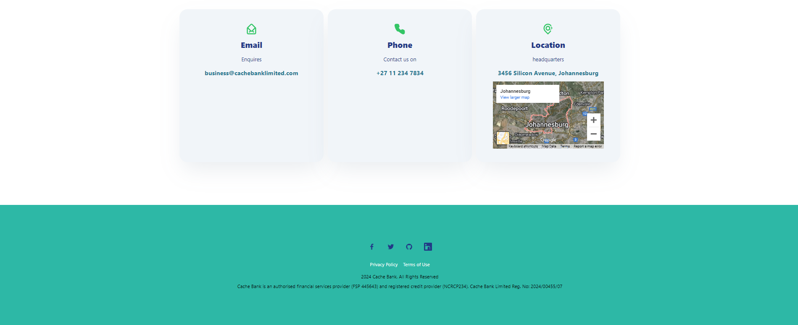
Component 5 - Contact and Footer

Slide 15
Conclusion
Project Objectives and Achievements
Header
- Objective: Provide easy navigation.
- Achievement: Included logo, navigation links, and action buttons for login and signup.
Hero Section
- Objective: Capture user attention and communicate main message.
- Achievement: Featured bold headline, supporting text, and call-to-action buttons.
Endorsements Section
Objective: Build credibility.
Achievement: Displayed logos of reputable companies like Amazon and Nike.
Technical Skills and Knowledge Gained
HTML & CSS
- Structured and styled webpage using HTML and CSS.
- Utilized Tailwind CSS for efficient styling.
Responsive Design
Created layouts that adapt to different screen sizes using media queries and flexbox/grid.
JavaScript
Basic understanding for potential interactive elements (e.g., mobile menu toggle).
External Libraries and Frameworks
Integrated Google Fonts, Leaflet, and Tailwind CSS.
Version Control
Experience with Git for managing changes and collaboration.
Technical skills and knowledge gained
- Developed comprehensive understanding of modern, responsive web development.
- Enhanced skills in HTML, CSS, and integration of external libraries.
- Gained insight into user experience and visual design importance.
Summary
Working on this project provided a comprehensive understanding of creating a modern, responsive web page. It enhanced my technical skills in HTML, CSS, and responsive design, and offered experience in integrating external libraries and frameworks. The project also touched on the importance of user experience and visual design in web development.

Slide 16

“
"The most important investment you can make is in yourself."
warren buffet

Slide 17

CONTACT
www.codespace.co.za
@codespace_academy
emma@codespace.co.za

